Slide 1
Coarse-Graining for Coupled Oscillators
A case study in discovering low-dimensional dynamics
Jordan Snyder, Andrey Lokhov, and Anatoly Zlotnik
SIAM Conference on Applications of Dynamical Systems
Snowbird, UT
23 May 2019
Notes:
Hi, I’m Jordan Snyder and I’d like to tell you about some work I’ve been doing on coarse-graining the dynamics of coupled oscillators. I’m wrapping up my PhD at UC Davis, and this work was done in collaboration with Anatoly Zlotnik and Andrey Lokhov at the Center for Nonlinear Studies at LANL.

Slide 2
The general problem
Given a high-dimensional time series, is there a low-dimensional effective dynamical model that describes it well? If so, what is it?
One way to view collective behavior: existence of an effective model with few degrees of freedom
Cayton, L. (2005). Algorithms for manifold learning. Univ. of California at San Diego Tech. Rep, 12(1-17), 1.
Notes:
The general problem I’d like to address is this: given a high-dimensional dynamical system, is there a dynamical description of lower dimension? And if so, how can I find it? I want to focus particularly on /data-driven/ methods so that we can hopefully help out silicon-based friends do science with the rest of us.
And in connection with the theme of this minisymposium, I want to point out that for me, existence of a lower-dimensional dynamical description is one way to formalize the notion of collective behavior.

Slide 3
Why the general problem is hard
We don’t necessarily know:
That there is an effective model to be found
The dimension of the effective model
The map from original degrees of freedom to effective degrees of freedom
The form of the equations governing effective degrees of freedom
ODE? SDE? PDE? SPDE?? Stat mech???
As a first step, consider a system where we can effectively reason about all of the above
Synchronization on a modular network
Notes:
Now let me point out that I know that the problem I’ve just stated is tremendously difficult and quite beyond what I claim to accomplish presently. We don’t necessarily know….
So we turn to a relatively well-understood system that nonetheless exhibits phenomena of the sort I’ve described, which is synchronization on a modular network

Slide 4
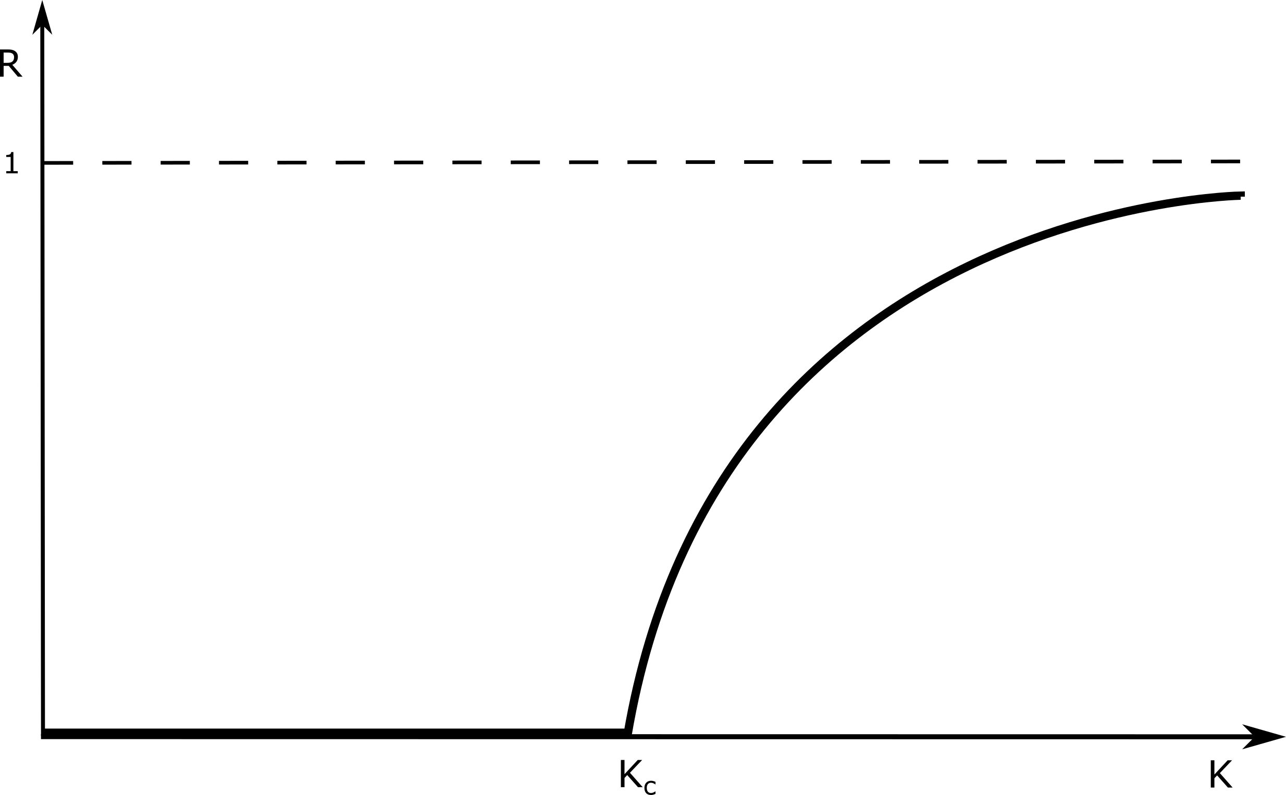
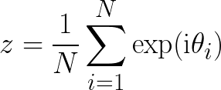
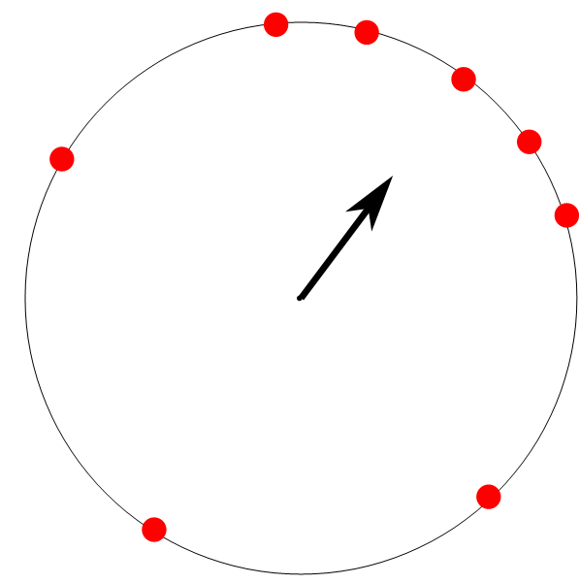
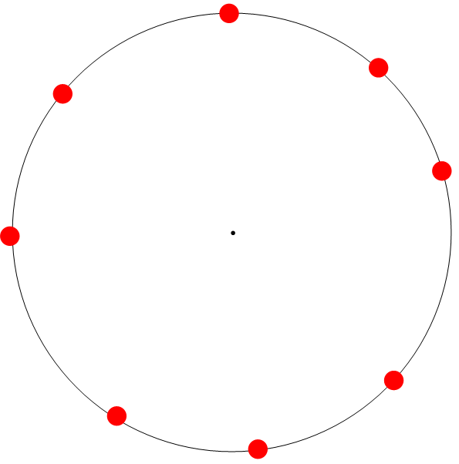
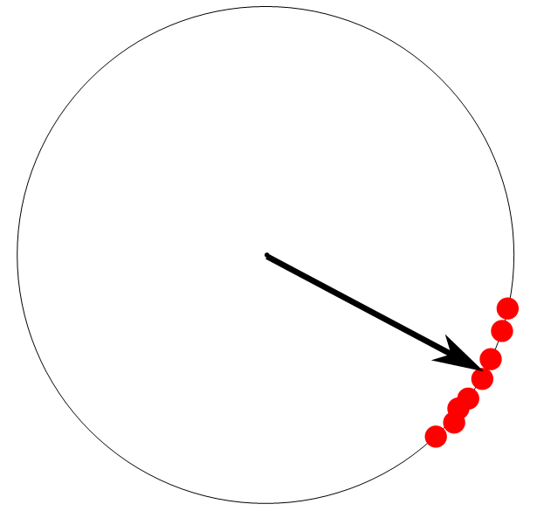
The fruit fly of collective behavior: Kuramoto Model
Key features:
Heterogeneity:
Coupling drives phases together
Order parameter:
Notes:
To begin I’ll briefly introduce the Kuramoto model.
The Kuramoto model is this ODE, which describes a population of N oscillators. Each oscillator has a phase theta that evolves according to a natural frequency omega and attractive coupling to the other oscillators. The key features of this model are the heterogeneity of natural frequencies, typically represented by a distribution g from which the frequencies are drawn, and the attractive nature of the coupling. Their trade-off can be tuned by the parameter K, and is typically measured by the order parameter z, which is written here. Geometrically, it is simply the center of mass of the population of phases when considered as points on the unit circle in the complex plane, like this [first image].
The classic result is that R, the magnitude of z, is near zero for small K but suddenly becomes positive at a critical value of K [second image]. In terms of the phase distributions, it looks like this [third image].

Slide 5
Reduced model via the Ott-Antonsen ansatz
In the limit , the order parameter obeys an autonomous ODE
If , then
Ott, E., & Antonsen, T. M. (2008). Low dimensional behavior of large systems of globally coupled oscillators. Chaos: An Interdisciplinary Journal of Nonlinear Science, 18(3), 37113.
Notes:
The property I want to focus on is the existence of low-dimensional dynamics, which are best exemplified by the Ott-Antonsen ansatz. The OA ansatz defines a low-dimensional invariant manifold in a Fokker-Planck formulation of the Kuramoto model; Ott and Antonsen showed that on that manifold, the order parameter obeys an autonomous ODE, and moreover, that under mild assumptions that manifold is attracting.
The resulting equations is here. You can see that z rotates with frequency Omega, is linearly damped towards zero with strength delta (heterogeneity), and coupling term destabilizes z=0 while drawing z towards |z|=1. In a way, the whole population (as represented by z) behaves as a single giant oscillator.
In the language of coarse-graining, the OA ansatz on a mean-field Kuramoto model gives us a way to coarse grain the whole system into one unit. It’s natural to seek behavior that is organized at a scale in between single oscillators and the whole population; a direct way to see that is to suppose a modular coupling structure.

Slide 6
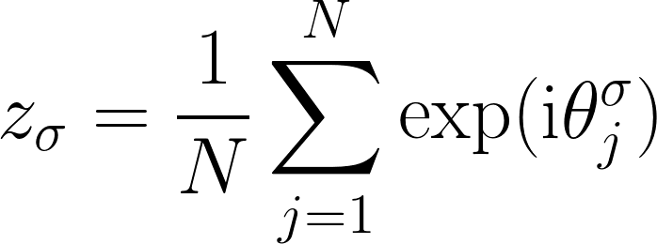
Modular Coupling → “Meta-Oscillators”
Coupling network has modular structure
Strong coupling within modules
Weak coupling between modules
Measure synchrony with cluster order parameters:
Notes:
What I mean by modular coupling is that the oscillators are divided into groups such that the coupling is strong within groups and weak between them. Mathematically that looks like this, and schematically it looks like that. In this situation, we can also measure /local/ order by cluster order parameters, defined here; we simply average the complex phase over a single cluster rather than the whole system.
The OA ansatz also establishes coarse-grained equations for this case

Slide 7
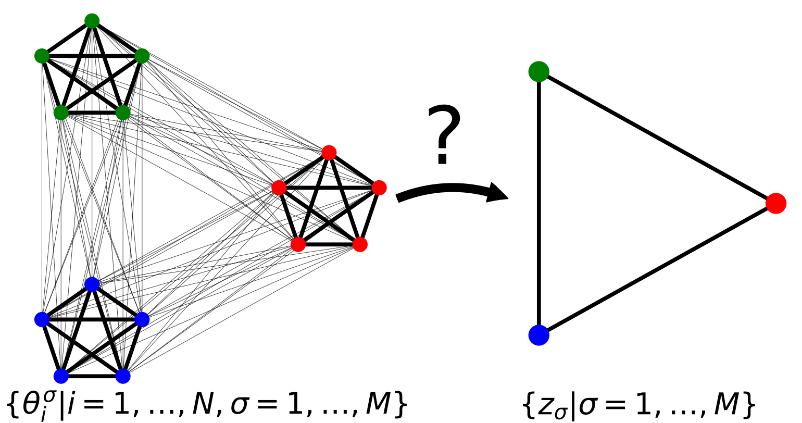
Coarse-Grained Equations of motion
If , then as [1]
Relies on population average behaving deterministically
Does the same reduction work for small N?
[1] Ott, E., & Antonsen, T. M. (2008). Low dimensional behavior of large systems of globally coupled oscillators. Chaos: An Interdisciplinary Journal of Nonlinear Science, 18(3), 37113.
Notes:
They look like this.
So, do these equations effectively describe mesoscale behavior of small networks? Let’s look at some numerical experiments and see what happens.

Slide 8
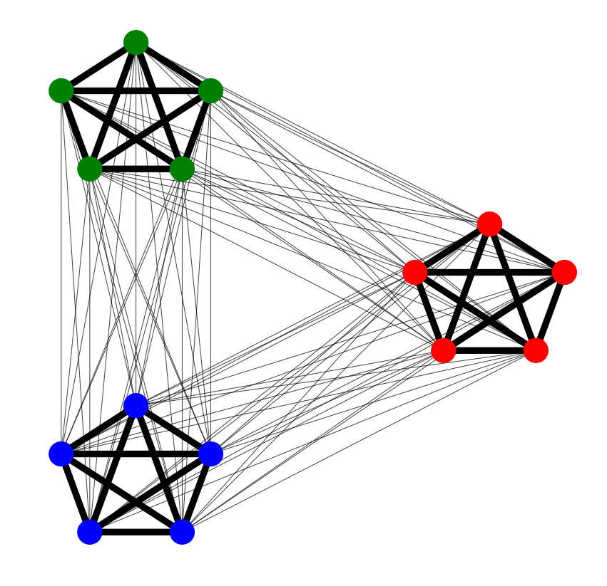
Numerical Experiments: Three by Five
Fifteen node network, three modules of five nodes each:
Sample natural frequencies and freeze for all experiments
Two control parameters:

Slide 9
$$K_{out}$$
$$K_{in}$$
Notes:
What you’re looking at is a system of fifteen oscillators. The natural frequencies and initial conditions are identical in all four frames, all that differs are coupling parameters. K_in is the coupling between nodes of the same color, and K_out is coupling between nodes of different color.
[hit play]
What you see is that for low coupling, we don’t see coherence. I don’t expect a CG model to work very well here.
If coupling is very high, the whole system synchronizes and we expect there to be a 1D description of the dynamics.
For high Kin and low Kout, we see something that could very reasonably be described by a single meta-oscillator of each color.
This suggests that internal coherence of a module should be predictive of how well a coarse-grained model works. Before I fully justify that statement, let me be more precise about what I mean.

Slide 10
$$K_{out}$$
$$K_{in}$$
Notes:
What you’re looking at is a system of fifteen oscillators. The natural frequencies and initial conditions are identical in all four frames, all that differs are coupling parameters. K_in is the coupling between nodes of the same color, and K_out is coupling between nodes of different color.
[hit play]
What you see is that for low coupling, we don’t see coherence. I don’t expect a CG model to work very well here.
If coupling is very high, the whole system synchronizes and we expect there to be a 1D description of the dynamics.
For high Kin and low Kout, we see something that could very reasonably be described by a single meta-oscillator of each color.
This suggests that internal coherence of a module should be predictive of how well a coarse-grained model works. Before I fully justify that statement, let me be more precise about what I mean.

Slide 11
Inferring equations from data
Given time series of all phases, we can compute a time series of cluster order parameters.
Q: do the order parameters evolve according an equation of this form?
Check using simple least-squares regression, for each σ:
Notes:
If the cluster order parameters evolve according to an equation of this form, I should be able to detect that from their time series by a direct linear fit. It looks like this.
I compute the time derivative by finite-differencing, and then compute each of the terms that makes up the right-hand size; the linear term (identity) and each of the coupling terms. Recovering the coefficients is then a linear inference problem.

Slide 12
Quantifying fit of CG model: Training Error
Training error is the residual of the least-squares problems
Small training error means dynamics of coarse variables are nearly autonomous
True
Inferred

Slide 13
Sometimes you get junk. Error ≈ exp(-3)

Slide 14
And sometimes it works well! Error ≈ exp(-14)

Slide 15
Local synchrony predicts training error

Slide 16
A discrete condition: phase locking

Slide 17
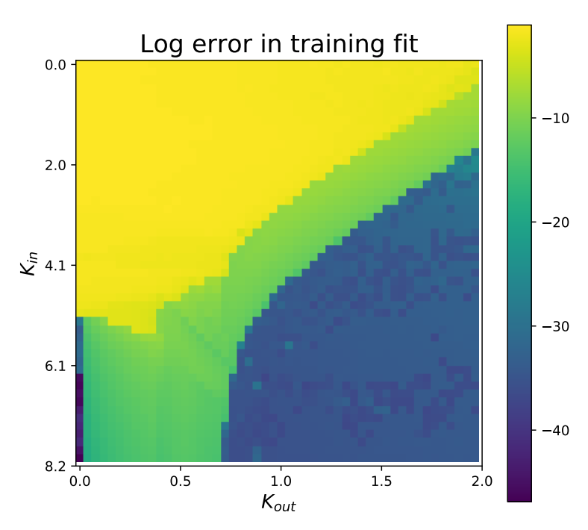
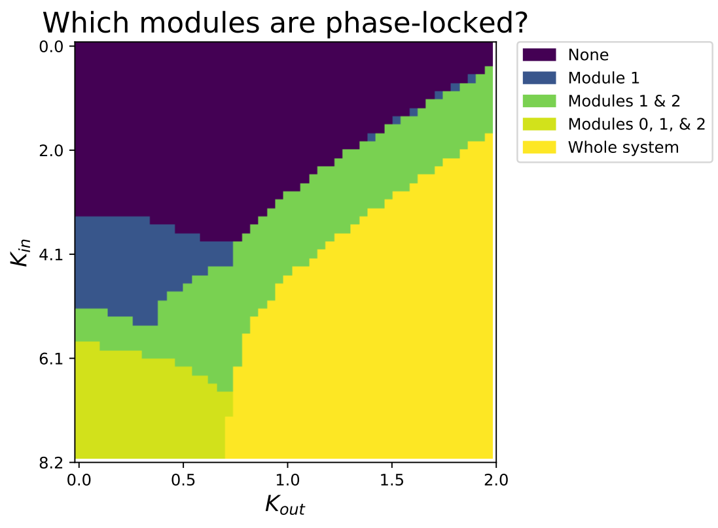
Phase locking predicts training error better

Slide 18
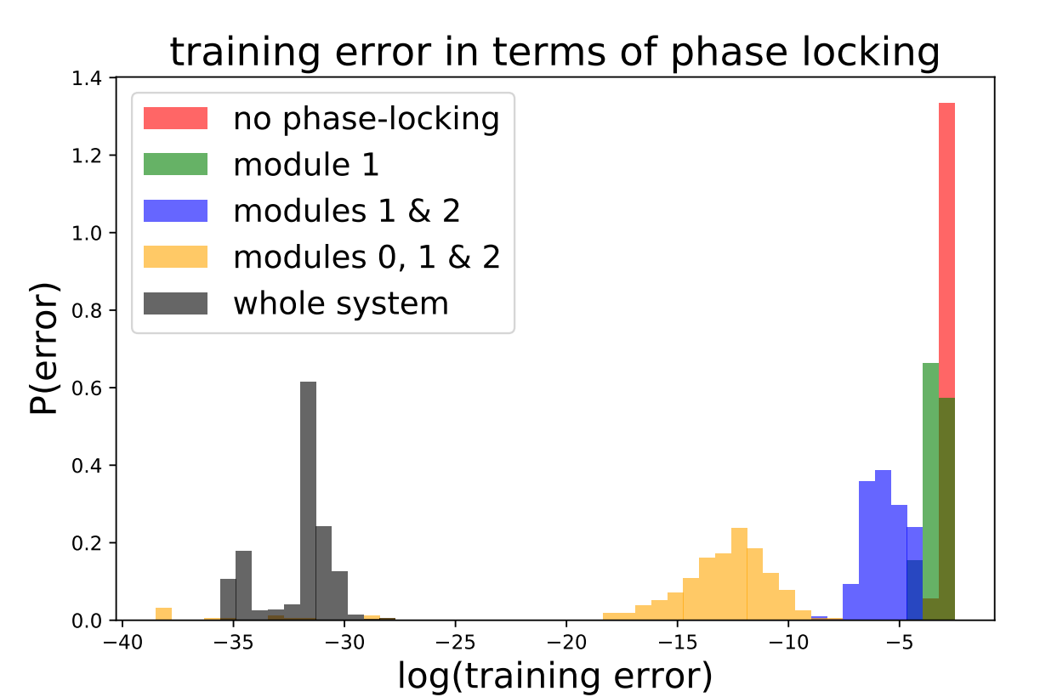

Slide 19
Are we looking at the right clusters?
Coarse-graining performs well when oscillators within a module are phase locked
Use this insight to identify clusters
Definition: the dynamical partition is the coarsest partition of nodes such that nodes in each partition element are phase locked

Slide 20
Finding clusters from the dynamics
Since phase cohesiveness appears to be critical to a good fit, use it as a criterion to find clusters

Slide 21
Dynamical partition mostly outperforms structural
Notes:
We can see from this histogram that overall, we get a better-fitting model by coarse-graining according to phase-locked clusters rather than structural modules. Most clearly we see many fewer instances of very poor fit. However, we still see some. How can we understand the failure modes of a dynamical partition?

Slide 22
Phase locking need not respect the network structure
Colors = phase-locked clusters
Partitions can be related by refinement. Formally,

Slide 23
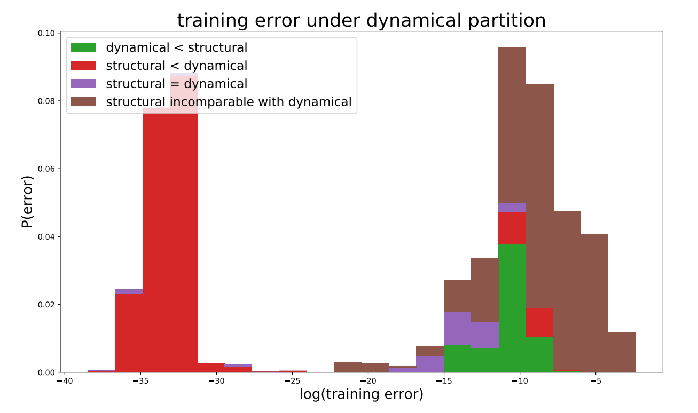
Fit is worst when phase locking does not respect network structure

Slide 24
Combining phase locking and network structure: Meet of partitions

Slide 25
Coarse-graining works best when both dynamics and network structure are accounted for

Slide 26
Conclusions
Equations arising from OA ansatz can also apply to finite networks
Precise coarse graining depends jointly on dynamics and network structure

Slide 27
Future work
It’s possible to write dynamics of coarse variables exactly if you allow dependence on fine variables. General question: how to eliminate time-dependence?
Average over time
Infer fine variables as a function of coarse variables: collective coordinates? [2]
Relax assumptions on form of CG equations: SINDy [3] or related
Does CG model give predictive power?
What if reduced dynamics are chaotic?
[2] Hancock, E. J., & Gottwald, G. A. (2018). Model reduction for Kuramoto models with complex topologies. Physical Review E, 98(1), 012307.
[3] Brunton, S. L., Proctor, J. L., & Kutz, J. N. (2016). Discovering governing equations from data by sparse identification of nonlinear dynamical systems. Proceedings of the National Academy of Sciences, 113(15), 3932–3937.

Slide 28
Thanks!
jasnyder@math.ucdavis.edu

Slide 29
Prediction
Ideal: we discover a low-dimensional model that reproduces exactly the behavior of the original system
Evaluate models by using them as a surrogate:
Infer parameters using true trajectory up to some time
Integrate inferred model using initial conditions from the true trajectory
Compare

Slide 31
How badly can the dynamical partition do?
This is the worst case of any CG model inferred on a dynamically-determined partition.
The partition has two sets, one of which is a singleton (orange)
K_{in} >> K_{out}, so cluster average is strongly not representative of total influence
Idea: if dynamical partition refines the structural one, this problem shouldn’t happen!

Slide 32
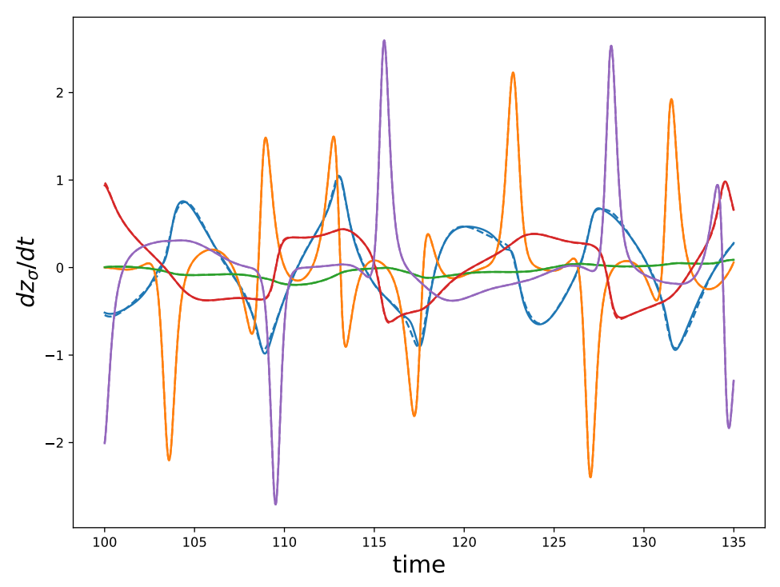
New worst case: much better!

Slide 33
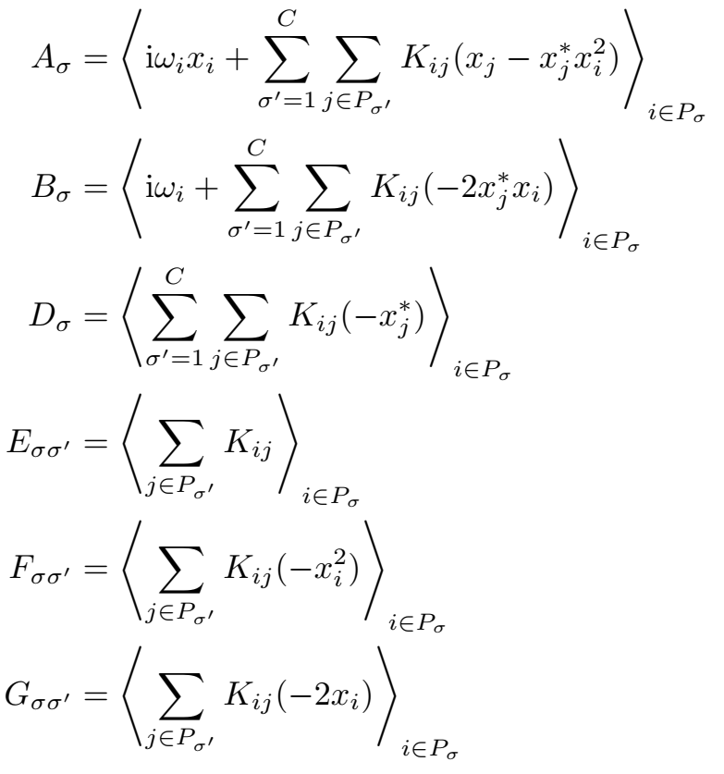
Exact dynamics of the coarse variables:
In terms of the residuals:

Slide 34
A pair of modules behaves like a pair of oscillators
Due to rotation invariance, a pair of oscillators only has one degree of freedom, which evolves as

